Slide 1

COMPUTER NETWORKS
(BCSC 0008)
Copyright content, use only with the written permission of presenter mentioned
Lecture

Slide 2
Text and Reference Books
Text Books:
Fourouzan B. A. (2004), “Data Communication and Networking”, 4th Edition, McGraw-Hill.
References:
Kurose, J. F. and Ross K. W. (2005), “Computer Networking: A Top-Down Approach Featuring the Internet”, 3rd Edition, Addison-Wesley.
A. S. Tanenbaum (2006), “Computer Networks”, 2nd Edition, Prentice Hall India.

Slide 3
Basics
The IPv4 addresses are unique and universal.
An IPv4 address is 32 bits long.
The address space of IPv4 is 2³² (4,294,967,296)
32 bit address is divided into 4 octet ( also known as byte)
To connect on internet each device requires a unique IP address

Slide 4
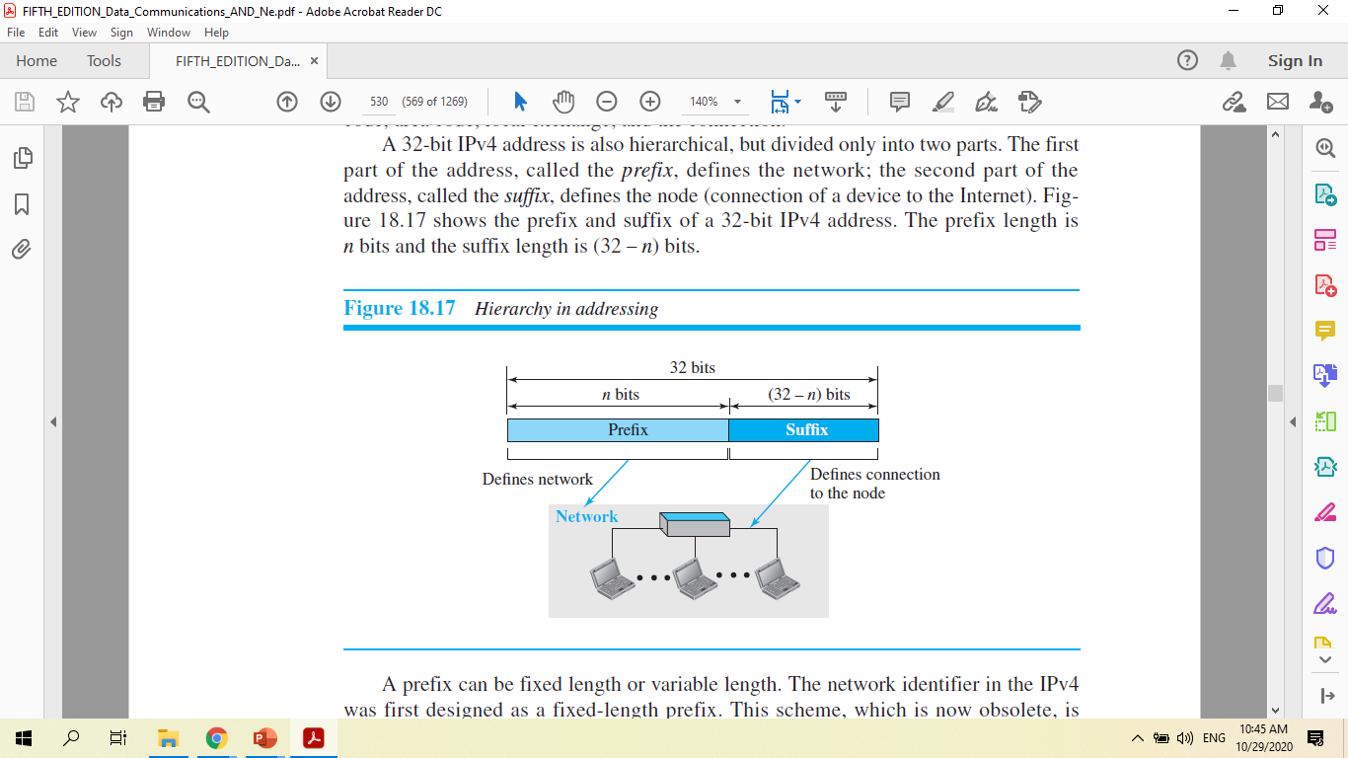
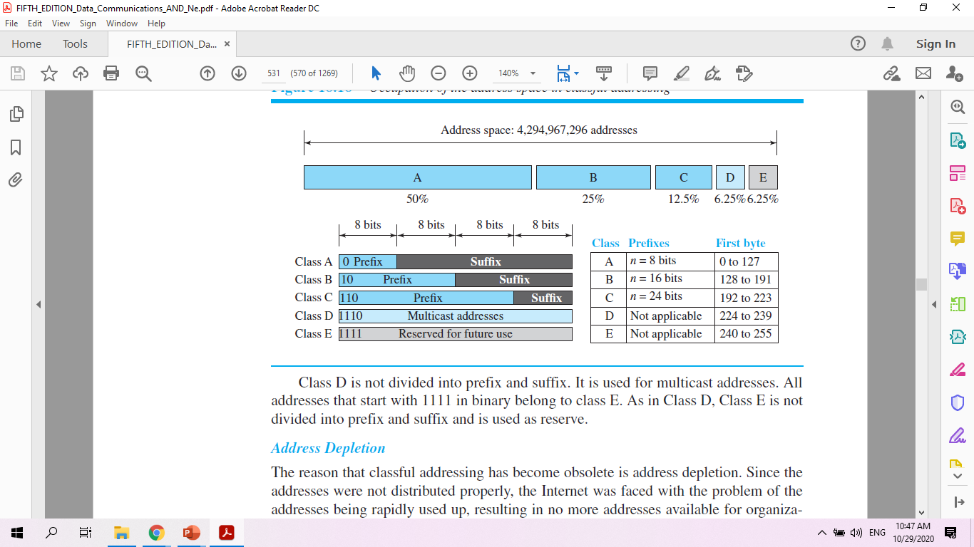
Classful Addressing

Slide 5
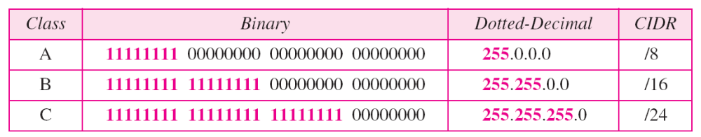
Fixed subnet mask

Slide 6
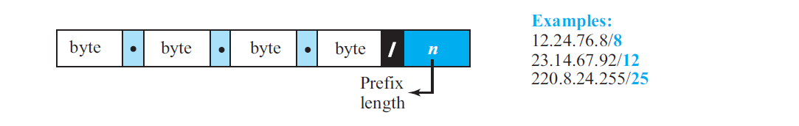
Classless Interdomain Routing (CIDR)
  In classless addressing, a block of addresses can be defined as x.y.z.t /n, in which x.y.z.t defines one of the addresses and the /n defines the mask.

Slide 7
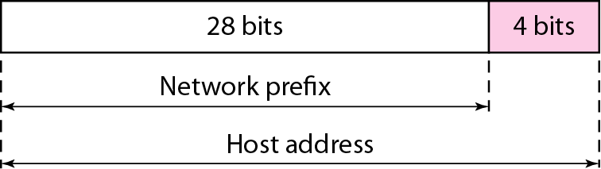
Variable length subnet mask (VLSM)
Example one IP:192.168.23.45/28
Network mask?
Set network bits all 1’s
11111111. 11111111. 11111111.11110000
255.255.255.240
First Address: IP address AND with MASK
Last Address : IP address AND with Negation(MASK)

Slide 8
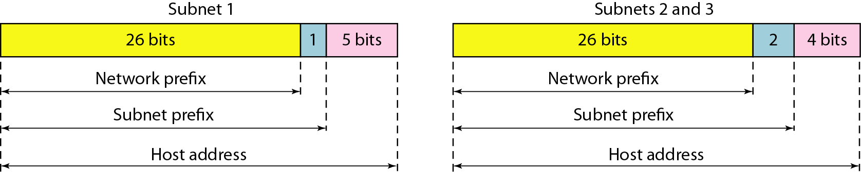
Subnetting
Divide a large address block into smaller sub-groups.
ISP provides 192.168.32.0/26, organization wants to create various sub-network.
To calculate VLSM subnets and the respective hosts allocate the largest requirements first from the address range
Requirements levels should be listed from the largest to the smallest

Slide 9
Example
Suppose ISP provides 172.12.14.0/26 to an organization. They have three offices and requires 32, 16 and 16 address in each office. How many address can be created? What is network mask? What is subnet mask, first and last address of each office? Design it.
Remaining bits=6 so, no of address=2^6=64
26 bits are fixed for defining network. Network mask=/26=255.255.255.192
To create subnet->Borrow bits from host portion.

Slide 10
Address allocation
Office-1 (subnet-1) mask, first and last address?
  Subnet mask= 255.255.255.224
  First addr=172.12.14.0/27
  Last addr=172.12.14.31/27
Office-2 (subnet-2) mask, first and last address?
  Subnet mask= 255.255.255.240
  First addr=172.12.14.32/28
  Last addr=172.12.14.47/28
Office-3 (subnet-3) mask, first and last address?
  Subnet mask= 255.255.255.240, First addr=172.12.14.48/28 - 172.12.14.63/28

Slide 11
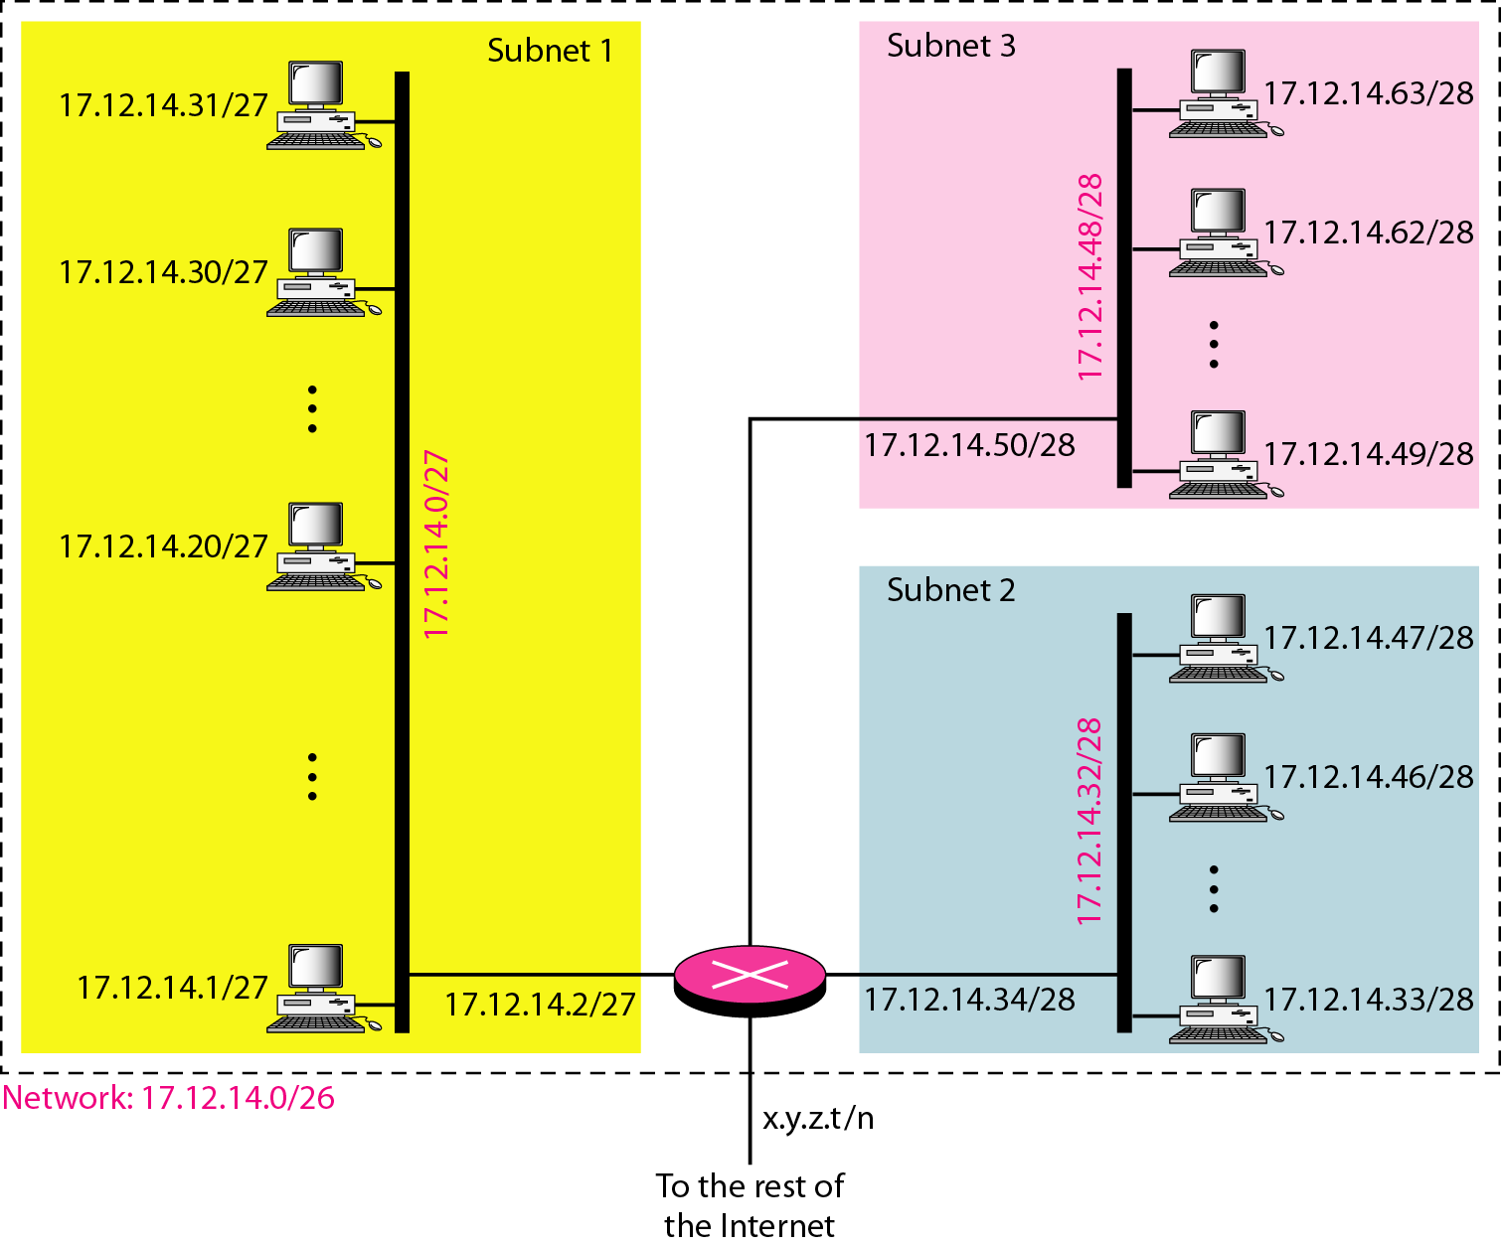
Design

Slide 12
Example
An ISP is granted a block of addresses starting with 190.100.0.0/16 (65,536 addresses). The ISP needs to distribute these addresses to three groups of customers as follows:
a. The first group has 64 customers; each needs 256
addresses.
b. The second group has 128 customers; each needs 128
addresses.
c. The third group has 128 customers; each needs 64
addresses.
Design the subblocks and find out how many addresses are still available after these allocations.

Slide 13
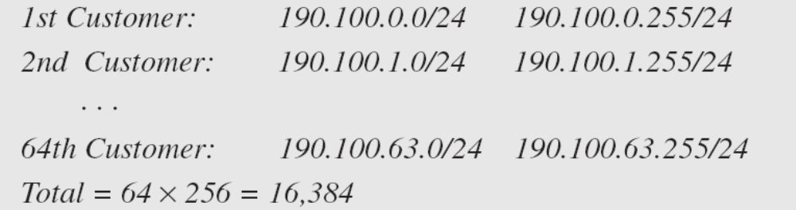
Group 1
For this group, each customer needs 256 addresses. This means that 8 (log2 256) bits are needed to define each host. The prefix length is then 32 − 8 = 24. The addresses are

Slide 14
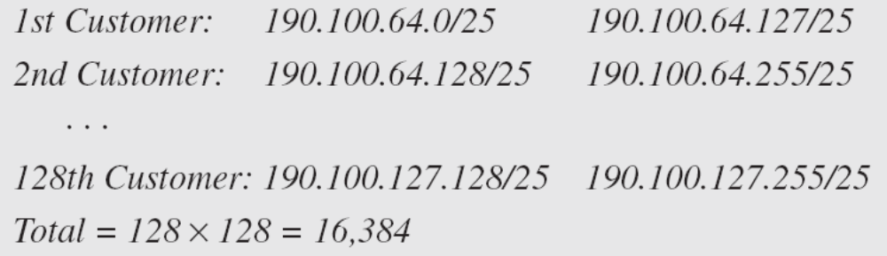
Group 2
For this group, each customer needs 128 addresses. This means that 7 (log2 128) bits are needed to define each host. The prefix length is then 32 − 7 = 25. The addresses are

Slide 15
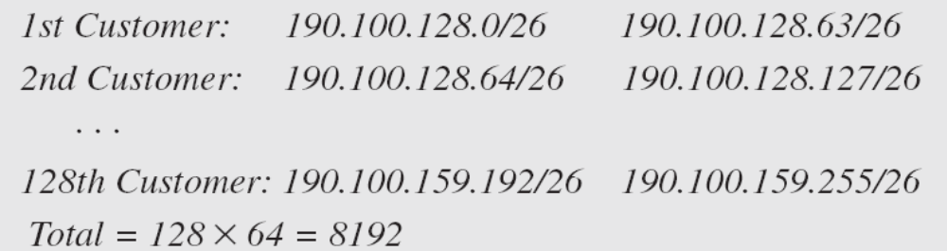
Group 3
For this group, each customer needs 64 addresses. This means that 6 (log₂64) bits are needed to each host. The prefix length is then 32 − 6 = 26. The addresses are

Slide 16
Answer
Number of granted addresses to the ISP: 65,536
Number of allocated addresses by the ISP: 40,960
Number of available addresses: 24,576

Slide 17
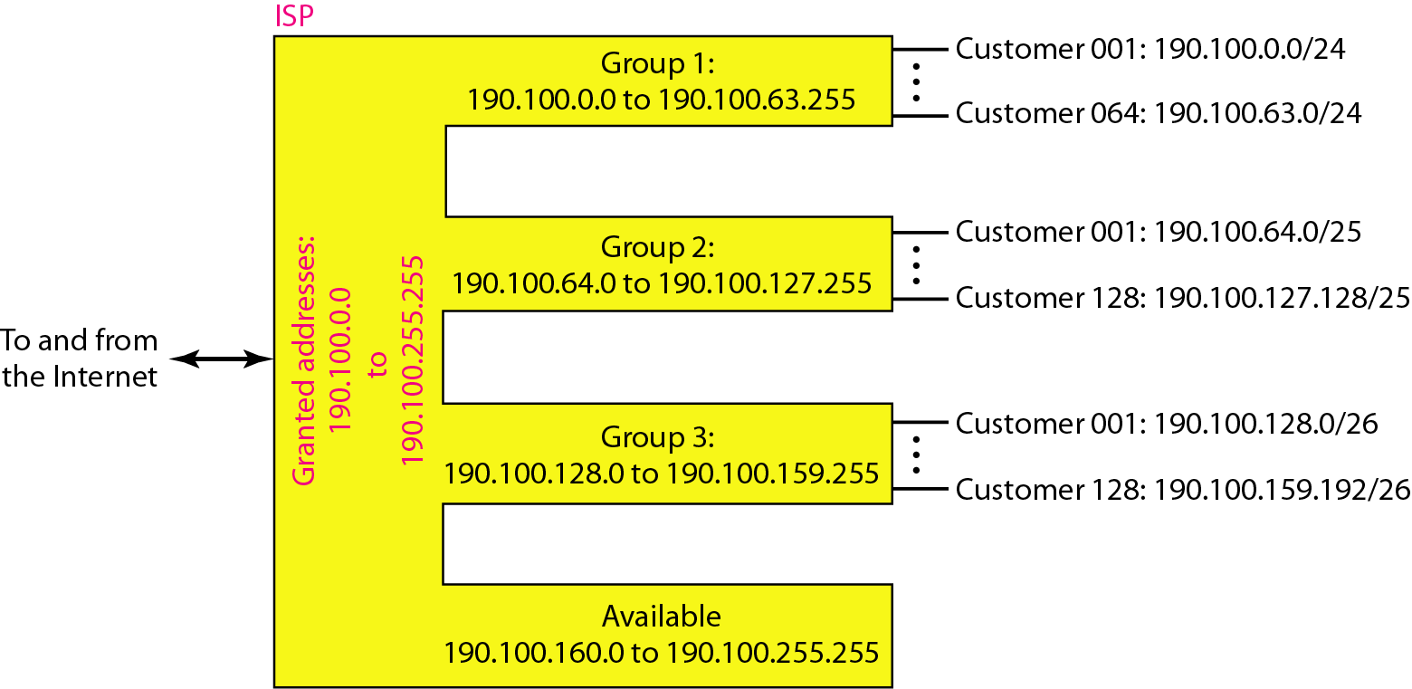
IP Assignments

